Slide 1

FoodHub
Coded by:
Backend: Levente Tüdős
Frontend: Bence Budai

Slide 2
The purpose of our project?
Create an enviroment
1
Search freely between recipies
2
Share your own recipie
3

Slide 3
The tasks for the Backend
Server side connection
Communication between
the server and the database
the server and the website
Creating REST APIs

Slide 4
The tasks for the Frontend
Making the design
01
User friendly
Compatible with the Backend
Responsive so it can be used on all devices (PC, Laptop, Phone, etc.)
Making tests so we can be sure that the website works intended
02
Using the modern coding styles and softwares, code languages
03

Slide 5



Backend technologies
NodeJS
JavaScript
Express.js
MySQL

Slide 6
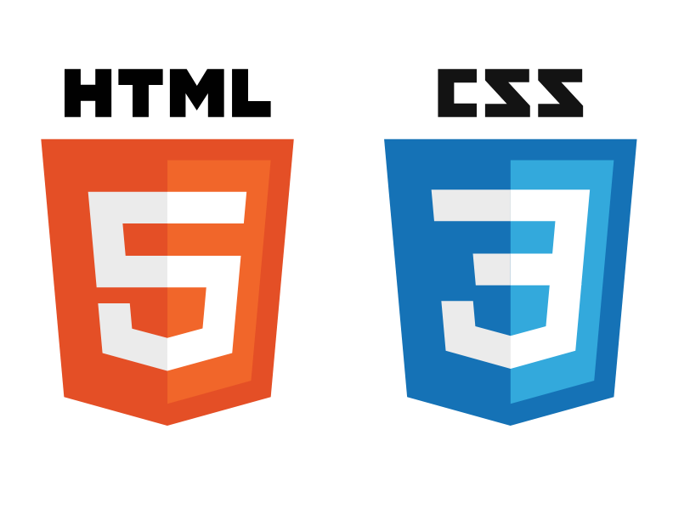



Frontend technologies
Bootstrap
Figma
JavaScript
CSS
HTML

Slide 7
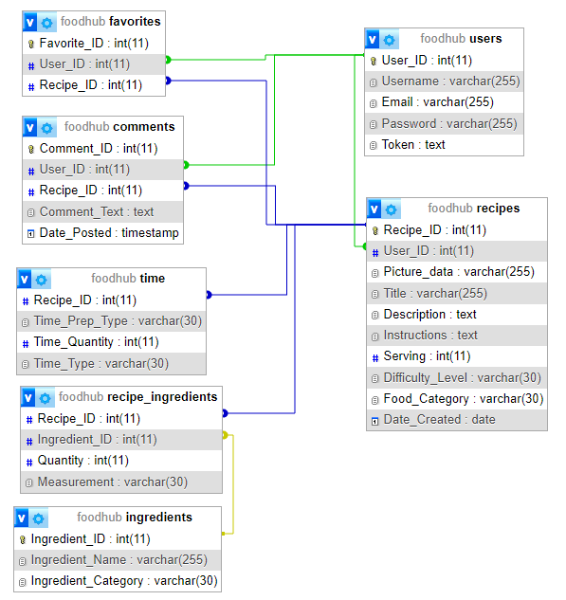
The database structure

Slide 8
Thank you for your attention!

